Slide 1
Dynamic Reteaming:
When Does It Make Sense to Adjust Team Membership?
Hans Samios
hans@focussedagile.com
hans.samios@iconagility.com
Notes:
There is a tendency in Agile Transformations to think that “stable” means “we have to keep people together” so we have a chance at creating a “high performing Team”. In reality there is typically a lot of movement of people in Teams, and somehow organizations are still successful. The question becomes “when is it OK to have movement between Teams; what are the conditions?” This session is an exploration of some ideas.

Slide 2
Agenda
Why This Session?
Benefits of Reteaming
(Some) Reteaming Patterns
Foundations for Reteaming
Conclusion

Slide 3
Why This Session?

Slide 4
“Enterprises … create long lived teams and teams-of-teams”
  SAFe - https://www.scaledagileframework.com/agile-teams/
Notes:
This text comes from the Scaled Agile Framework article on Agile Teams. Here there is the assumption that Agile Teams are long-lived.
Sources: https://www.scaledagileframework.com/agile-teams/

Slide 5
“Keep teams stable and avoid shuffling people around between teams. Stable teams tend to get to know their capacity, which makes it possible for the business to have some predictability.”
  Scrum PLoP
Notes:
This text comes from Scrum PLoP (Scrum Published Patterns).
Source: https://sites.google.com/a/scrumplop.org/published-patterns/product-organization-pattern-language/development-team/stable-teams

Slide 6
“Team exists as long as capability exists”
  “Characteristics of a Stable Team”
Notes:
This text comes from a client’s “characteristics of a stable team”. This common knowledge is reflected in our own materials.
What is interesting to me is that the the client in this case had a very different experience. In FI we saw 50% churn rate on Teams so, to put it simply, stable Teams in the traditional way is simply not happening.
This is being caused by several factors – off-shoring, how people advance through jobs (say every three years).
My thinking that we should acknowledge this reality and see what, if anything, we can do about it.

Slide 7
“If reteaming is going to happen, we might as well get good at it.”
  Anonymous
Notes:
Or to put it another way, for this client we needed to become good at it.

Slide 8
Benefits of Reteaming

Slide 9
A Place for Judicious Change
Removing a toxic / ineffective member of the team
Adding a specific skill set to a team, to overcome something which is impeding delivery
Changing the dynamics of the team
Fresh blood
Notes:
A long time ago in a previous life I did a set of analysis to understand what the effect was of changing Teams members; we called it a churn analysis. The idea was simple – track changes in Team personal over time and understand what impact this had on velocity. The results turned out as you might expect in that adding or subtracting a Team member from a Team resulted in an average loss of velocity by Team of 21% for the next three Sprints.
But what was interesting was that this was not always the case. There were several cases where the velocity of the Team improved as a result of change. Interviews with related leadership revealed potential causes, which are included in the slide.
Source: https://www.hanssamios.com/dokuwiki/what_is_the_effect_of_changing_team_members_on_velocity

Slide 10
Reduce the risk of
  Attrition
  Learning stagnation
  Career stagnation
  Knowledge silo development
While maintaining high performance
Notes:
Which brings me to today. I recently became aware of a book whose premise was that, unlike conventional wisdom, there are actually quite a few reasons you might want to embrace changes in Teams, that there were a number of standard patterns where this will make sense, and that we should understand these approaches and know when to apply it.
The book was called “Dynamic Reteaming: The Art and Wisdom of Changing Teams” by Heidi Heifand.
And it points out these benefits of becoming good at reteaming.
Source: https://www.amazon.com/Dynamic-Reteaming-Wisdom-Changing-Teams-ebook/dp/B07WDYR6H3/ref=sr_1_1?dchild=1&keywords=dynamic+reteaming&qid=1590511612&s=digital-text&sr=1-1

Slide 11
Tuckman Model
Notes:
We are all familiar with the “Tuckman Model”. It is used to justify the notion of stable Teams with the idea that, with the time spent getting to “high performing” you better keep high performing Teams together as long as your can.
This picture is one used by a lot of people. Tuckman later updated his model to include a step, post performing, called “Adjourning” where the Team got disbanded, and performance was not as high. One premise of the book is that Tuckman forgot a step, a step called “stagnation” where the Team is doing fine, but are really not getting any better. This step could last for a long time.

Slide 12
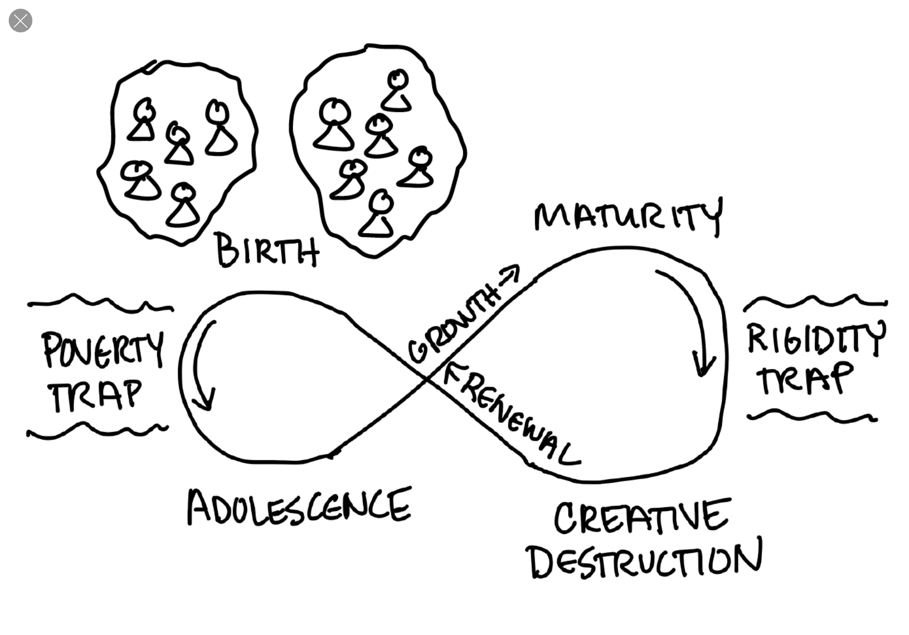
The “Ecocycle”
Source: “Dynamic Reteaming: The Art and Wisdom of Changing Teams” by Heidi Heifand
Notes:
In fact the book goes one step further to suggest that a Team goes through stages more like an eco life cycle, from birth to maturity, to creative destruction, to renewal, and so on.
The picture here shows what happened with a Team that started as a single team. It was birthed as a single team but received enough investment to get to adolescence, then grew further to maturity. But then they were a big team and the team was taking a long time to plan, attend dailies, and so on. Result was that they decided to break into 2, a process of creative destruction, which ended up through a renewal process to represent the new birth with 2 teams.
Why is this important? I’m sure you’ve been asked the question “how long will it take to get to a high performing Team?” Part of the issue is that the Tuckman model implies that you can go through these steps, and bingo! After X months you will have a high performing Team. Reality is that while we know a lot more about characteristics of high performing Teams, they are still elusive. And while there are a lot of reasons for that, I think the Tuckman model is part of the problem. Teams are much more organic than that, and when you add in changes over time, are better modelled and thought about as organic.
I will say, most of us probably think this way already. While the Tuckman model might help new Teams understand what we are trying to get to, as an organizational framework, the eco cycle is probably a better tool.
Source: “Dynamic Reteaming: The Art and Wisdom of Changing Teams” by Heidi Heifand

Slide 13
(Some) Reteaming Patterns
Notes:
From the book, there were a number of times where it might be OK to reteam. The following slides represent a subset of the 44 patterns identified. These are divided into three basic catagories:
. Business need to reteam
. Code need to reteam
. Human need to reteam
Now I don’t agree with all of these, but I think it brings up an interesting discussion; if this approach has worked somewhere else, what is it about my experience that has been different.
Let's go through some of the standard patterns

Slide 14
(The Business Need to Reteam)
Growing the Company
Cell division: Grow a team “big,” and split it in half
  Higher level with Team-of-Teams
Put a new engineer on a team with existing engineers

Slide 15
(The Business Need to Reteam)
New Product Development
Take engineers out of current teams. Put them into a new team.
  Isolate them from other teams.
  Tell people not to bother them.
  Give them complete process freedom.

Slide 16
(The Business Need to Reteam)
“High Performance” Anti-Pattern
Move existing team members out of a “high performance” team
  In order to spread out the “high performance” among the other teams

Slide 17
(The Code’s Need To Reteam)
Focus on Technical Debt and Sustainability
Take engineers out of standard teams, put them in an infrastructure team
  Give them process freedom.
  Let them work on what the code needs

Slide 18
(The Code’s Need To Reteam)
Address Challenges Posed by the Code
Take team members off of existing teams to solve a short term challenge.
  Isolate the team and give them process freedom.
  Dissolve the team when the challenge is accomplished.

Slide 19
(The Human Need To Reteam)
Reteaming to Find Fulfillment
Switch an engineer to another team in order to work with the people or content they want.
Hack Days: Temporarily break up all teams for 24 hours.
  Facilitate activities to derive content and team formation.

Slide 20
(The Human Need To Reteam)
Reteaming to Learn
On a regular basis, rotate an engineer from one team to the next in order to stimulate learning and camaraderie.
Switch engineer from a specialized team like tech support onto another team in order to gain knowledge to bring back to their team.
Switch engineer from an existing team over to another team for a short term in order to share specialized knowledge with the other team.

Slide 21
(The Human Need To Reteam)
Reteaming to Liberate
Acknowledge that you have one team embedded within another team.
  Break them into a separate team and “reset” the team to help them find their process.

Slide 22
Foundations for Reteaming

Slide 23
What Do We Need to Put In Place?
Common roles, events, and artifacts; common terminology
Psychological safety
Faith that the people that are closest to the work should make decisions about the work
Notes:
Not covered as much in the book but there was a set of core understanding in the organization that allowed reteaming to happen more easily. So this is my list
SAFe really helps here because of the standardized approach to roles, events and artifacts.

Slide 24
Conclusion

Slide 25
“If reteaming is going to happen, we might as well get good at it.”
  Anonymous

Slide 26
Want to Know More?
Website: http://www.heidihelfand.com
Video: https://www.youtube.com/watch?v=WEgQBAk7ivs

Slide 27
Questions?

Slide 28
Revision History
2020-06-30: Removed specific customer references and “goodbye” slide. Add in “description” with at the beginning of the pitch so people can understand purpose. Added emphasis on eco-cycle model approach.
2020-05-26: Initial Version

