Slide 1
Leading By Example with Personal Agility
(A personal story)
Hans Samios – hans@focussedagile.com

Slide 2
Notes:
When I first encountered Agile, I was taken by how much it all made sense to me. But when I tried to tell others of my newfound knowledge, I found that I was less than convincing.

Slide 3
My World (2007 Edition)
My inbox always had 600 items in it, with 150 arriving every day.
My workday was about processing these emails and attending meetings; whatever was “hot” at the time.
I’d get to the end of the day and realize that I had no view of what I’d accomplished.
I was always tired, felt I sat in my seat all day, and felt guilty every time I took a break to stretch my legs.
I read “work” books on the weekend, so I wouldn’t interrupt my “real” work.
I’d find that while I busy, I missed important work, forget I started something, never quite complete things, and so on.
I’d find myself procrastinating, unable to start things that required effort, let alone finish them.
I knew there were things I could do to improve how I work, but never found the time to improve.
Notes:
I had a lot of problems at work at the time. Perhaps some of these resonate with you. And its kind of interesting. This type of discussion is exactly what we hear from Teams when we start them off on Agile.
We know how to make Teams more effective. It seems pretty clear that it should be possible to apply some of those same principles and practices to my normal day-to-day, and those make more effective use of the capacity that I have.
Now I’d like to say that it was really clear that, and that overnight I became this effectiveness machine. Problem is that is simply not true. That last statement (“I knew there were things I could do to improve how I work, but never found the time to improve”) was the real problem. It took me a long time to get to where I am now, probably too long, and I will tell you that like all “continuous improvement” the process never stops.

Slide 4
Getting Email Under Control
Notes:
Here’s a question for you (and some of you might have already heard me ask this) - how many items are in your inbox today? This morning, I had three items in my inbox. My goal is that, at the end of each day, I have a maximum of 5 items in my inbox. Interesting right, but there is more to it than that.
Christmas, of 2009, I came to an interesting realization. As said, my inbox always had 600 items in it, with 150 arriving every day. Every Christmas, before I’d go home for the holiday, I’d work through my inbox and get the number of items down to (say) 25. And I’d feel like I could relax. But then February would come around. And guess what, my email was back at 600 again. And then for some reason, it stayed around 600. How is this possible that I could keep my inbox at 600, but not at 25?
The realization I came to was that it was me, and the system I used for email, that was the problem. Because of how I processed email, the system was steady-state at 600.
Was 600 the ideal number? I knew I had problems. I was not always as responsive as I should be. Often things that I should respond to were missed. I seem to spend a lot of time reading, and re-reading the same email over and over again. And as a result of my new background in lean and agile I thoughts “hmmm, 600 is probably not goog” – it seems like a really long queue of work.

Slide 5
How Did I Get to ”Maximum 5”?
Progressive targets: 300, 150, 75, etc.
”Cannot go home until you hit the target”
Watch what you do with email, for example:
Keep it because “I need a reminder to come back to this …”
Keep it because “I think need to read it in the future …”
The massive tree of folders …
In 6 months got to 50 as the magic number
Notes:
Since I was at 600 emails I had to determine how to get it down to 300 and then maintain at 300. Once I did this, target was the 150, 75, etc.
To get disciplined about this I set the primary “rule of the game” – you cannot go home until you hit the target. This forced me to work the issue. And through this I found that by working through the queue I noticed that there were several common things that I could do to remove them from the queue – heuristics that worked for me. For example:
A number of these were only in the queue because I needed to come back to them at some future date. So I got these out of the inbox by dragging them into tasks (using Outlook) and setting a date when I look at it again. This meant my daily planning now also included a quick glance at the task list for the day.
Another thing I noticed was then number of “keep this in case I need to read it again” or “keep this because I probably should read it”. I became more aggressive about disposing of these figuring if it wasn’t important enough to do something about it when I first saw it, it was unlikely to get more important and, if it did it would portably come back in the form of another email. So I filed them.
And a final thing I noticed was that my filing system was ridiculous – a massive hierarchy. Problem was that I would often need to file things in two or more ways (by customer, by person, by activity) and so not only was it hard to file anything, it was also hard to find anything. But then I discovered that “search” worked pretty well so now I have only two categories “business” and “personal” and that works pretty well.
In the end it took me about 6 months, and I was below 50 on a regular basis. Getting to 10 was easy from there.
I want you to think about what this means. I basically was giving myself back my capacity. I didn’t waste as much time re-reading emails and managing emails. The time could be better used.

Slide 6
My World (2012 Edition)
My inbox always had 600 items in it, with 150 arriving every day.
My workday was about processing these emails and attending meetings; whatever was “hot” at the time.
I’d get to the end of the day and realize that I had no view of what I’d accomplished.
I was always tired, felt I sat in my seat all day, and felt guilty every time I took a break to stretch my legs.
I read “work” books on the weekend, so I wouldn’t interrupt my “real” work.
I’d find that while I busy, I missed important work, forget I started something, never quite complete things, and so on.
I’d find myself procrastinating, unable to start things that required effort, let alone finish them.
I knew there were things I could do to improve how I work, but never found the time to improve.
Notes:
Ok cool. I’d addressed the big time-suck of email. But let’s face it, no one will say that getting better at email means I am more productive. It just means I am freeing up capacity. If that capacity is not well directed, then I have not achieved much.
I am sad to say that even with this success, it took me a long time to take the next logical step. To directly apply what I knew from Scrum in my day-to-day knowledge work. What do I mean by this? If you look at these problems, these are problems knowledge worker have at an individual level that people have at the Teams level. And the tool we recommend to address that is Scrum.

Slide 7
Applying Scrum to Me …
Prioritized backlog
Planning
Small items
Retrospect
Iterations backlog?
Demonstration?
Notes:
I sat back and thought about the basics of Scrum. How can I apply Scrum? My first pass was to look at Scrum and figure out what seems to make sense when I try to apply to me as an individual. So what is Scrum and how do I apply it to me as an individual? Clearly the role definitions in Scrum didn’t make much sense to a “Team of 1”. So what did make sense?
The idea of a prioritized backlog seemed like that would help me work on the most important thing.
I figured planning was a good idea, so that I wouldn’t just be reacting to the last thing.
Small items seemed like a logical fit, perhaps less than a day in most cases, so I could see progress.
Taking the time to retrospect would allow me to improve. Cool.
What I wasn’t sure about was:
Iteration backlog. 2 weeks seemed just silly given the changing nature of my work. Something closer to a day, or even less than that might make sense. But how to break down the work?
Demonstration: Not sure how I’d demonstrate to in the general case. For specific work items, getting feedback was just part of the work.

Slide 8
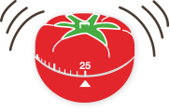
Iteration Backlog: The Pomodoro Technique
Choose a task you'd like to get done
Set the Pomodoro for 25 minutes
Work on the task until the Pomodoro rings
When the Pomodoro rings, put a checkmark on a paper
Take a short break
Every 4 pomodoros, take a longer break
Source: https://francescocirillo.com/pages/pomodoro-technique
Notes:
As part of a general search on improving effectiveness I came across a technique called “the pomodoro technique”. Pomodoro means “tomato” in Italian. OK, I thought the name was silly as well. But it turns out the name had relevance. In Italy the clockwork timers you have in the kitchen are often in the shape of a tomato. The idea behind the pomodoro technique is that you do work in 25minute increments, then have a break for 5 minutes, and continue. It is suggested that one of these kitchen timers are used to make that happen.
This sounded suspiciously like using a cadence to drive focussed work at a sustainable pace. And so I mapped my personal daily iterations as being made up of a series of these 25min events.
So where did I end up?
Source: https://francescocirillo.com/pages/pomodoro-technique

Slide 9
(Redacted ☺)
Notes:
This is what I came up with as a result of this thinking. Notice the date. August 2012. Since I’ve been doing Agile since 2006/2007 you can tell that I am a pretty slow learner.
The top left you can see the backlog, labeled “initial plan”. You can see one item to “get email below 10 items” so the email experiment was definitely in progress at this juncture. Note that there is estimate on the items, its just a prioritized list where the order is based on both “whats important” and “what event (such as meetings) do I need to go to.
You can see that there is a long list of break-ins. Pretty clearly I was not very good at planning at this point. But I think this is also what we see when we kick of teams – a lot of hidden work that needs to be exposed. Interestingly I recently became worried about break-ins again, and so I am tracking them again to see how big an issue there is.
And you can see a long list “what happened”. These are observations about the day (and this is just one day!) I just started using the pomodoro technique and so there were a lot of observations there – how long things took, what it was like to run for 25 mins, and so on. I was questioning the use of text as the mechanism to plan and track progress; surely there was something better.
This was the beginning of my journey into personal agility. Every day from here on in my day started the same way. I’d put aside some time for planning for the day. Since I was text based, I’d take a copy of the previous day’s page, and then edit it to reflect current day.

Slide 10
(Redacted ☺)
Notes:
This is what may plan looks like today, or rather on Tuesday. You can see there are a lot of differences between what was in 2012 and what we have now:
Sections to help group like work – reminders (typically as a result of learning), stuff I do every day, big events, the backlog today, and the attic (where old items go)
Every item has a estimate on it. 1 it means “1 iteration” or rather one 25 min pomodoro.
Personal retrospective is separated into its own page, and is done weekly
Other separate pages collect related work. For example, you can see an enter called “Determine approach to take for ‘Leading by Example with Personal Agility’ Preparation”. This page is based on a template I’ve developed over time to make sure I do a reasonable job in presentations.
Items are crossed-off as they are done.

Slide 11
My World (2020 Edition)
My inbox always had 600 items in it, with 150 arriving every day.
My workday was about processing these emails and attending meetings; whatever was “hot” at the time.
I’d get to the end of the day and realize that I had no view of what I’d accomplished.
I was always tired, felt I sat in my seat all day, and felt guilty every time I took a break to stretch my legs.
I read “work” books on the weekend, so I wouldn’t interrupt my “real” work.
I’d find that while I busy, I missed important work, forget I started something, never quite complete things, and so on.
I’d find myself procrastinating, unable to start things that required effort, let alone finish them.
I knew there were things I could do to improve how I work, but never found the time to improve.
Notes:
This is what my world looks like today.
My day starts by reviewing email that came in over night, then developing the plan for the rest of the day. I then work through the backlog in order, one task at a time. I don’t worry so much about Pomodoros timing any more as I now have a pretty natural rhythm of working for 20-25 minutes, then having a break, except when I am in meetings☺ If something breaks in during the day, I just add it in the appropriate place in the backlog, and designate it as a break-in. If I notice a problem, I create an entry in the retrospective page based on a template and then work it. I also take a little time at the end of the week to retrospective on the week.
I have on occasion tracked metrics using this data. For example, there was a time where I was concerned that I was not giving enough time to one of two sets of people I was doing work for. A quick count of items based on type of work allowed me to validate that I was doing OK. No longer concerned about this, I stopped tracking the metric.
But as said, this is me. This is what I did to improve. You might have a totally different approach. For example, I know of people that use Kanban boards like Trello to track their daily work. I am a “text” kind of guy, so this approach suites me.

Slide 12
Leading-by-example
Notes:
But just a minute, didn’t you say something about “leadership?” How does that fit in to this discussion?
Great question! And to answer we are going to watch this video.
Source: https://www.youtube.com/watch?v=fW8amMCVAJQ

Slide 13
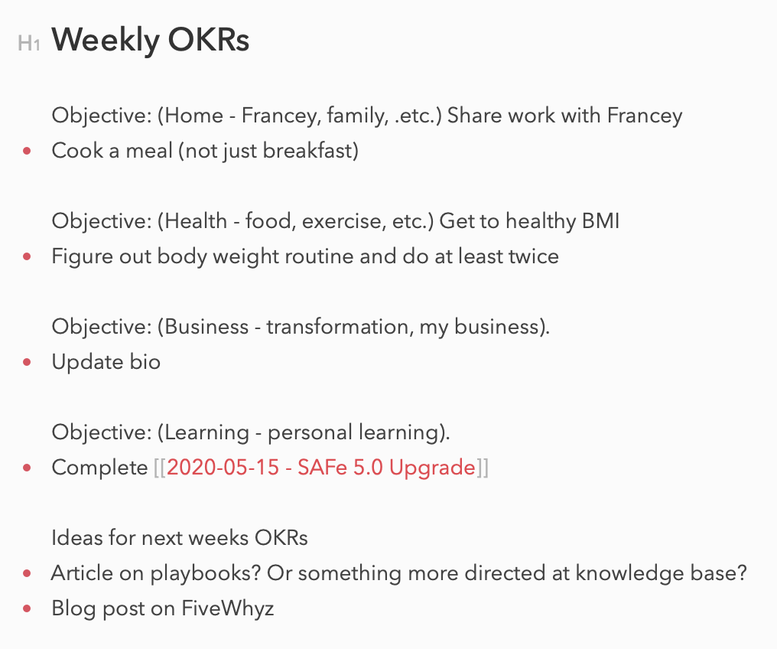
Confidence and Authenticity Through Practice
Notes:
Recently I was working a problem within FI. The problem we had was that we were not doing a great job of aligning on the top priorities for work, staying focused on the one or two “most important things”. Sure we had a prioritized list, but there were a lot of things on the list. We needed to make sure that we had alignment on the two or three things that we really needed to focus on in the upcoming quarter.
Now the tool that seemed appropriate to the job was the idea of OKR – objectives, key results – whereby we set a few objectives, and the measure progress to those objectives through key results. Now I’d done the research. I’d listen to videos, read the book, discussed with other coaches, etc. But I actually had not implemented OKRs in any meaningful way.
But when I thought about it, I actually had this problem as well. There could be weeks where I’d accomplish good stuff everyday, but at the end of the week, I’d feel I hadn’t really done the one or two “most important things”.
I decided to run personal OKRs. You can see the set that I am working through for this week. Now while I am sure this makes riveting reading, and while this process has helped me focus on ”important things” for the week, there was another benefit.
Now, when speaking with leadership about OKRs I can speak from experience. Over the weeks of using personal OKRs I’ve seen benefits. I’ve seen what makes a good set of key results, how many you should have, processes that seem to help. I feel confident in what I am saying because I’ve seen it work.
I also had this benefit for application of agile practices and principles. I know they work, because I’ve used them. I may seem like the Dancing Man in the video, with all kinds of crazy ideas, but I am also confident and authentic, and the result is that some will be influenced as a result.

Slide 14
Benefits of Personal Agile
Increases your capacity to do work
Improves your ability to deliver value
Allows you to establish control of your day
Allows you to rapidly adapt to new situations (e.g. WFH)
Increases authenticity of your Agile practice so you can lead-by-example

Slide 15
Want To Know More?
Discussion of Kanban, Get Things Done, Pomodoro technique:
https://www.infoq.com/minibooks/three-pillars/ *
Pomodoro technique:
https://francescocirillo.com/pages/pomodoro-technique
* WARNING: Bit of a sales pitch for a app

Slide 16
Questions?

Slide 17
It Has Been a Real Pleasure!
Last day for me at the end of May
Feel free to reach out:
hans@focussedagile.com
@hanssamios
Linked-in Hans Samios
Personal knowledge base: hanssamios.com

Slide 18
Revision History
2020-05-25: Added in “procrastination”
2020-05-21: Initial presentation to SM CoP
2020-05-19: Added in speaker notes
2020-05-18: Initial version

