Slide 1
WSJF and COD
Prioritizing and Scheduling Work
Hans Samios @ Focussed Agile

Slide 2
Agenda
How to best use known capacity?
Is there a better way to schedule work?
Introducing CoD and WSJF
Benefits of CoD and WSJF

Slide 3
How to best use known capacity?

Slide 4
What are the problems with our implementation decisions?
Encourages “big bets” thinking for projects
For projects often require a long time to develop justification
Typically considers “sunk cost” as justification to continue investment
Typically made in silos
  For example, each project is considered the top priority by the project manager
Often requires that individual contributor often makes priority decisions
  As no overall direction on priorities for person / team
For “urgent issues” often based on opinions, not economic considerations

Slide 5
How do you decide what to work on next?
In other words “what is your current prioritization / scheduling approach?”
  First in – first out (FIFO)
  Loudest person request
  Request from person who nags the most (squeaky wheel)
  Highest paid persons opinion (HiPPO)
  Most valuable first
  Next item on “the list”
  Critical path analysis
  Other?

Slide 6
How important is it to calculate WSJF?
What is the fully burdened cost of a “train” (team-of-teams)?
  $12M - say 10 teams @ $100K per month
How much return do you expect for that investment
  $24M – say good 50% return plus factoring in some things that didn’t work as well as expected
Cost of a train is ~$500K / week
  This is the cost of slow decision making, per week

Slide 7
Is there a better way to schedule work?

Slide 8
Is there a better way to schedule work?
Let’s say we have 3 features we are going to schedule:
No matter the order we deliver the work in, the cost will be (almost) the same:
Feature | Estimated Cost | Estimated Value
Feature A | 3 weeks ($75K) | $75K
Feature B | 6 weeks ($150K) | $225K
Feature C | 4 weeks ($100K) | $175K
Notes:
Costs for IT organizations usually based on number of people.
Team cost per week – assume average burden rate of team is $100K / month or $25K / team (pizza sized team)
What this says is that we don’t really need to consider cost in scheduling decisions. The real question is how to best use the people we have.

Slide 9
Is there a better way to schedule work? (Continued …)
Which feature would you do first and why?
Feature | Estimated Cost | Estimated Value
Feature X | 3 weeks ($75K) | $75K
Feature Y | 3 weeks ($75K) | $175K
Notes:
Obvious – since effort is the same, deliver higher value item first so we can realize the on-going benefits of that value for a longer period of time.

Slide 10
Is there a better way to schedule work? (Continued …)
Which feature would you do first and why?
Feature | Estimated Cost | Estimated Value
Feature X | 3 weeks ($75K) | $175K
Feature Y | 6 weeks ($150K) | $175K
Notes:
Obvious, again. If they have the same value, deliver the one with smallest effort first so we can realize the return for a longer period of time.
What might not be so obvious for teams and individuals is that if there is no understanding of value, then the best assumption a person can make is that “all things have the same value”. This means that if a team does not understand the value, they should simply prioritize based on shortest job first.
Most organizations, when they see this, will decide this is not what they want, and so it will encourage people to work a more informed approach.

Slide 11
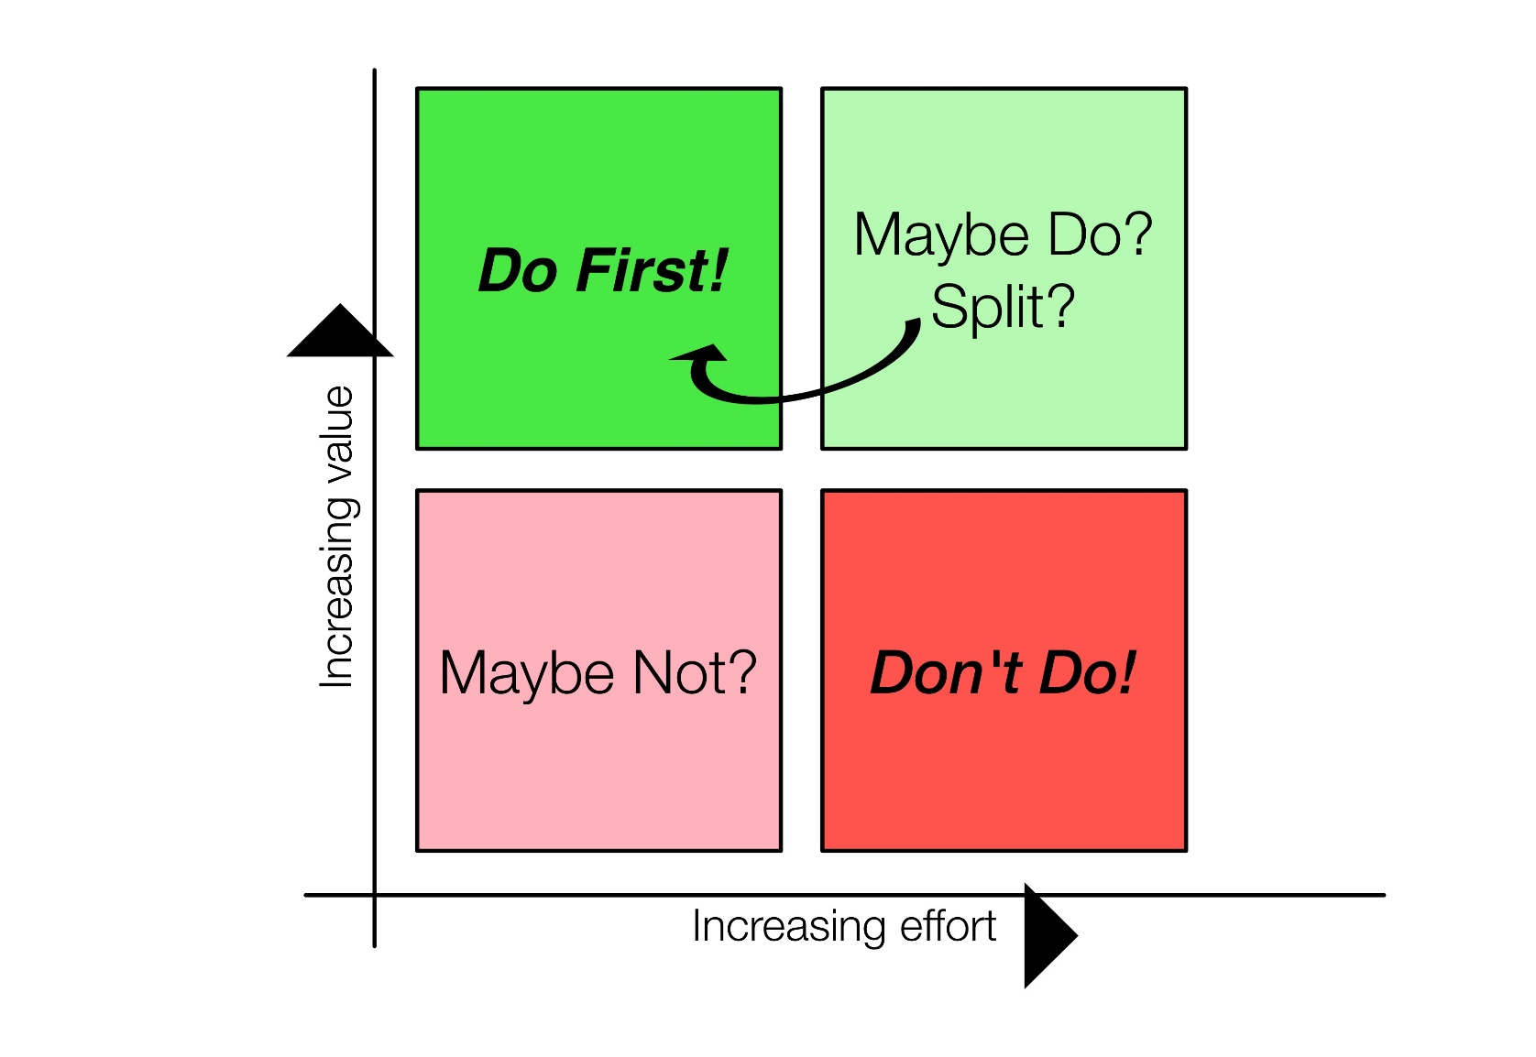
Is there a better way to schedule work? (Obviously …)
Need to determine how to trade
  Value delivered
  Cost (effort) to deliver
Notes:
Basic (obvious) idea. Do high value, low effort (and therefore cost) first. Don’t do high effort and low value at all – just say no. If you have high value items that take a lot of effort, then perhaps this should be broken down into smaller items to realize value. Can you say “minimum viable product”? For low value items, even if they are easy to do, perhaps the response should be “just say no”. After all, you end up taking away capacity from higher value initiatives.

Slide 12
Introducing CoD and WSJF

Slide 13
Introducing Cost of Delay
We want to deliver based on ability to generate most value for the capacity we have
  If asked, people will say “everything is valuable”
  Value alone doesn’t provide view of impact of time
Alternative question: “what will cost us the most by delaying its delivery”?
  I.e. while we don’t have this feature we are losing the money we could have had from this feature

Slide 14
Introducing Cost of Delay (CoD)
(Continued …)
Which feature would you do first and why?
Feature | Estimated Value | Estimated CoD | Comment
Feature X | $175K | $75K | Loses some value if not delivered by the deadline date
Feature Y | $175K | $175K | Loses all value if not delivered by the deadline date
Notes:
We would do the one where the CoD is higher – in other words we lose more money if we don’t do Feature Y first

Slide 15

“If you only quantify one thing, quantify Cost of Delay”
– Don Reinertsen “Principles of Product Development Flow”
Cost of Delay is "a way of communicating the impact of time on the outcomes we hope to achieve"

Slide 16
How is Cost of Delay (CoD) used?
$$Weighted Shortest Job First \left(WSJF\right)=\frac{Cost of Delay \left(CoD\right)}{Duration (size)}$$
We calculate the CoD value and then divide by how long it takes (size of work) to generate the WSJF score
Deliver most value (or cost of delay) and are shortest duration first
Higher WSJF means higher priority

Slide 17
How do we determine CoD values?
What are the levers that drive business decision making?
SAFe approach:
Business Value (BV)
  Revenue impact or cost savings
Time criticality (TC)
  Decay of value over time (eg critical delivery milestone)
Risk reduction or Opportunity enablement (RR/OE)
  Reduce risk of future delivery or create new business opportunities
CoD $=BV+TC+(RR/OE)$

Slide 18
How do we determine CoD values?
(Continued …)
We already know how to calculate size quickly
  Story points – relative size of work to others we are considering
We use the same kind of approach to generate a view of value
  Relative value to others we are considering
  I.e. Is this feature twice as valuable as another feature, three times, etc.
We will end up filling in a chart like:

Slide 19
How do we determine CoD values?
(Continued …)
Process for Business Value
  For each of the features we are considering in the coming quarter
  Find the one that offers the least value and call it a “1” sized Business Value
  Then go back to each of the other features and ask “in comparison to this Feature that we’ve identified as a 1, how much more valuable is this feature – 2x, 3x, 5x, 8x, 13x or 20x?”

Slide 20
How do we determine CoD values?
(Continued …)
Repeat process for Time Criticality and Risk Reduction / Opportunity Enablement
Sum Business Value, Time Criticality and Risk Reduction / Opportunity Enablement to calculate Cost of Delay
Divide Cost of Delay by Story Points to calculate Weighted Shortest Job First
Highest WSJF is top priority item

Slide 21
What is the difference when we schedule using WSJF?
Do “most valuable” first
Do “weighted shortest job” first
$77
$102
Do “shortest job” first
$97
Using previous features, WSJF delivers 102 of value (versus 97 and 77)
WSJF improve odds of delivering the most valuable work

Slide 22
What factors drive CoD estimation?
Business specific view of the levers:

Slide 23
When do we calculate WSJF?
SAFe recommendation:
Level | WBS | Frequency
Portfolio | Epic | Every 6 months
Program | Feature | Every quarter (for the next Program Increment (PI))
Team | Story | Only use if it helps

Slide 24
Benefits of CoD and WSJF

Slide 25
What are the benefits of using WSJF for prioritization?
Improve odds of delivering the most valuable work by taking an economic view of prioritization
Reduce the chance of personal preference or pet project work entering the work stream
Ignores sunk costs, if applied often
Allow continuous, quick, transparent prioritization decisions
Increase chances of buy-in from affected stakeholders
  A structured way to engage broader representation
  Uses decision rules to break deadlock with multiple stakeholders
  Uses decision rules to decentralize decision making
Reduce debate over prioritization because data is quantified
Encourages “good” behavior – smaller, more valuable work gets higher score

Slide 26
Questions?

Slide 27
Revision History
2015-05-10:
  Cleaned-up picture on relative value delivered
  Cleaned up picture of levers used to drive CoD
2017-05-09:
  Updated benefits
  Added section breaks
  Added agenda
  Added calculations showing results
2017-05-08:
  Updated example calculations
  Updated grid image to be a little less “black and white” in approach
2015-05-03: Initial Version

