Slide 1
Agile Project Management?
Agile Stakeholder Participation Benefits
How Does Project Management Change In an Agile / DevOps Environment?
Hans Samios @ Focussed Agile

Slide 2
Your project, the whole project, has a binary deliverable. On scheduled completion day, the project has either delivered a system that is accepted by the user, or it hasn’t. Everyone knows the result on that day. The object of building a project model is to divide the project into component pieces, each of which has this same characteristic: Each activity must be defined by a deliverable with objective completion criteria. The deliverables are demonstrably done or not done
Tom Demarco - Controlling Software Projects (1982)

Slide 3
Key Takeaways
Why are Customers not Delighted with the Outcome of A Project?
Application of Agile Thinking to Project Management
Customer Perspective
Understanding of Reporting Using Agile Metrics
Other Considerations (WIP)

Slide 4
Why are Customers not Delighted with the Outcome of A Project?

Slide 5
Why Are Projects Late?
General Manager | Project Manager | Item
1 | 10 | Insufficient front end planning
2 | 3 | Unrealistic project plan
3 | 8 | Project scope underestimated
4 | 1 | Customer/management changes
5 | 14 | Insufficient contingency planning
6 | 13 | Inability to track progress
7 | 5 | Inability to track problems early
8 | 9 | Insufficient Number of checkpoints
9 | 4 | Staffing problems
10 | 2 | Technical complexity
11 | 6 | Priority Shifts
12 | 11 | No commitment by personnel to plan
13 | 12 | Uncooperative support groups
14 | 7 | Sinking team spirit
15 | 15 | Unqualified project personnel
Notes:
Source: Genuchten 1991 IEEE

Slide 6
Why Are Projects Late?
General Manager | Project Manager | Item
4 | 1 | Customer/management changes
10 | 2 | Technical complexity
2 | 3 | Unrealistic project plan
9 | 4 | Staffing problems
7 | 5 | Inability to track problems early
11 | 6 | Priority Shifts
14 | 7 | Sinking team spirit
3 | 8 | Project scope underestimated
8 | 9 | Insufficient Number of checkpoints
1 | 10 | Insufficient front end planning
12 | 11 | No commitment by personnel to plan
13 | 12 | Uncooperative support groups
6 | 13 | Inability to track progress
5 | 14 | Insufficient contingency planning
15 | 15 | Unqualified project personnel
Notes:
Source: Genuchten 1991 IEEE

Slide 7
Project Management the Agile Way

Slide 8
What Does Project Management Involve?
Project Management is about answering the following questions:
When will the project be done?
How much will it cost?
Do we all agree on what done looks like?
What are the risks to getting done on budget and on schedule?
How will we mitigate these risks so we can get done?

Slide 9
Agile Changes Our Thinking
Most projects involving Systems are not predictable
Customer’s view of requirements change
Business conditions change
Our view of how we build the Solution changes
We typically do not allow changes
Agile / DevOps is a risk mitigation technique when our assumptions about predictability do not hold

Slide 10
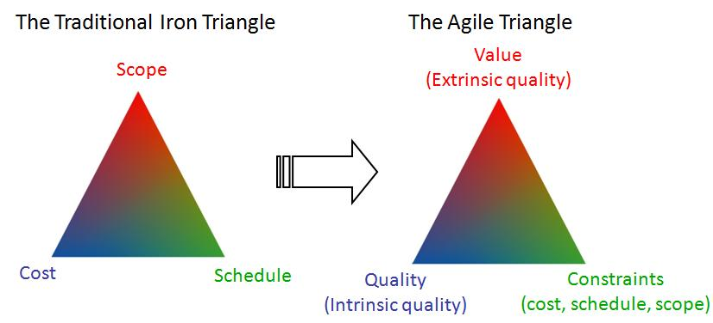
Agile Changes Our Thinking
Notes:
Source: Jim Highsmith
Project Managers are taught about the “Iron Triangle” of Scope, Cost and Schedule. The idea is that when you plan you can fix 2 of these variables, but you then have to let the third variable float. So if you want a fixed scope, and a fix schedule, you need to plan for variable cost. The reality is that most projects end up trying to fix all three of these variables. And when this happens, something has to give. Interestingly what typically gives is not even on this Iron Triangle. What you end up doing is cutting corners in an effort to “get it all done”, either by forcing people to work long hours (guaranteed to reduce quality) or by simply cutting tests or documentation that used to be considered important, but for some reason are now less so. Practically what this means is that you drop quality. And when that lever not available, you start jettisoning scope. Note that we jettison scope based on a plan we put in place when we knew the least about the actual requirement of the customer.
So we deliver lower quality. But the problem is even worse than this. According to Jim Highsmith “A number of studies have shown that 50% or more of functionality delivered is rarely or never used.” This is a well known conclusion from various Chaos Reports (Standish) over the years. Highsmith continues “This leads to the conclusion that scope is a very poor project control mechanism — we should be using value.” What does the customer value. Often they do not know at the beginning of the project but we set up a plan and pretend they do. The agile approach changes this thinking - “A traditional manager focuses on following the plan with minimal changes, whereas an agile leader focuses on adapting successfully to inevitable changes.” It is through this expectation, this discovery process, that agile project managers produce results.
This lead Jim Highsmith to update the view of the traditional iron triangle. Cost, scope and schedule are seen as constraints on the problem. Quality is treated as “fixed” (when has your customer ever said to you “give me all these features, on time, to this budget, but I would prefer it if the solution crashed every time I tried to run it and please don’t help me use it”). Value is delivered by a continuous discussion of scope – now that we have seen something, what have we learned both from a requirements perspective and a project delivery perspective, and how does this affect our plan.
“The aim is to provide a customer what they want at the end of a project, not what they thought they wanted at the beginning of the project.” And to do this in a controlled fashion.

Slide 11
When does any waterfall project become agile? When you're out of time or money. That's when you negotiate.
– Harry Koehnemann

Slide 12
Agile Change Our Thinking (cont)
A different focus:
Focus less on predictive up front planning
Focus more on delivering value
Focus more on collaboration with the business
Focus more on engaging the team
Focus more on delivering incremental value
Move to value based Project Management
Versus task based Project Management

Slide 13
Agile Change Our Thinking (cont)
A different approach:
Deliver working (Partial-)Solutions in short cycles
Keep the evolving Solution highly visible
Inspect outcomes frequently
Change our Solution or processes as we learn more to ensure acceptable outcomes
Do less work up front that is likely to change
Treat quality as “fixed” rather than a variable

Slide 14
How Does Agile Help (Software Example)?
Will have something (developers version) to show
Traditional Waterfall Model
1 week
Will actually know we have something complete
Agile Approach
Top value item delivered
2nd most valuable item delivered
Key
Requirements
Design
Development
Feedback: items not required
Certification

Slide 15
How Does Agile Help (cont)?
Get to business value quicker
Lowers investment
Increases return
Increase clarity of customer requirement
Assume customer knows 50% of real requirement upfront
Its probably the most important part; the core
Clarity comes as people see more
Avoid building things that aren’t required
Avoid overbuilding and therefore adding to complexity

Slide 16
How Does Agile Help (cont)?
Improve Project Management
Easier to plan short durations
Decrease risk as we know what we have
Top value item in 2 weeks as opposed to demo version in 9 weeks
Course correction at any time based on what people have seen
Add resources
Add to the schedule
De-scope project
Cancel project (good as long as we don’t lose huge investment)
Stop big jumps in status of project
Example: at month 6 we were on schedule; at month 7 we were 3 months behind
Best solution is to back out last months work then only 1 month behind
Reality is that at 6 months we didn’t know we had a problem
Results in stakeholders losing faith in delivery of their solution

Slide 17
How Does Agile Help (cont)?
Team perspective
Quick wins improve morale
Quick losses allow for learning and correction hopefully leading to quick wins
Team learns
Technical perspective
What if none of the above were true – is it still better to build in complete stages
Traditional:
Big Upfront Design means you cannot leverage learning as you build
Tendency to overbuild
Is harder to test, as there is more going on
Note: requires teams to focus on Building quality In

Slide 18
Does this Happen Overnight? No!
Learn to adapt the language of Project Management for agile
Time management (eg always deliver on time)
Cost management (eg defined by your willingness to invest)
Scope management (eg deal with scope based on project realities)
Risk management (eg see working software to reduce risks)
Quality management (eg built upfront in the plan)
Communication management (eg collaboration framework)
Integration management (eg change control built into the process)

Slide 19
Customer Perspective

Slide 20
What About the Customer / Contract?
We’ve trained the customer to expect certain things from software houses
There will be contracts!
If you can write the contract
Set it up so that it takes advantage of the iterations
If you cannot write the contract
Get trust by showing high value short term results
Report honestly on project progress
At appropriate time re-work contract details – at least there should be a level of trust!

Slide 21
“Avoid Building Fallow Functionality and Manage Scope Creep to Deliver Projects Within The Triple Constraints”
What The Client Cares About
How Agile / DevOps Delivers
Q: Will we deliver the requirements to fulfill the business case?
A: Avoid building fallow functionality by incorporating frequent feedback loops ensuring relevance of requirements that have not been built yet.
A: Avoid scope creep by forcing a prioritizing of scope based on expected value and available capacity.
Q: Q: Will we meet time-to-requirements?
A: Sequence high-value features to be delivered first and be able to cancel at any time and be left with working functionality representing existing investment.

Slide 22
“Avoid Building Fallow Functionality and Manage Scope Creep to Deliver Projects Within The Triple Constraints”
What The Client Cares About
How Agile / DevOps Delivers
Q: Are we going to stay within budget?
A: Save on cost by not building functionality that is not useful and high value.
A. Save on re-work cost since we are delivering on discrete “chunks” of tested and valuable functionality
A: Build discrete components early to provide valid estimates for cost to complete.
Q: Will we maximize value from the system?
A: Provide end users opportunities early in the project to influence implementation, thereby providing a more user oriented solution and creating evangelists when the project is released.

Slide 23
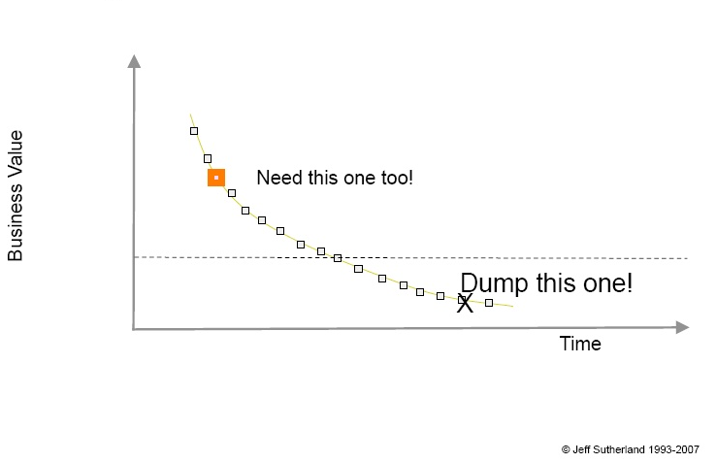
Client Can Change Their Mind By Swapping With Low Value Item of Equivalent Size
“Change for free!”

Slide 24
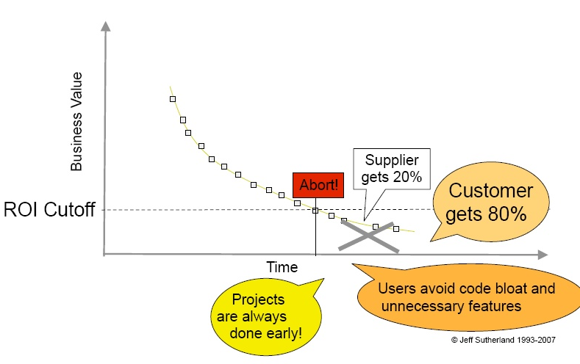
Offer Out For Client When Project Meets Her Needs
Customer determines ROI cutoff where implementation of the next feature costs more than the value of the feature.
Supplier allows termination of contract at any time for 20% of remaining contract value.
Goes into the deployment phase of the project
“Money for nothing!”

Slide 25
Samples of Reporting

Slide 26
Mapping Prioritization and Capacity To Schedule
Project
Start
Schedule
UAT
Start
Demo
Milestone
Demo
Milestone
Demo
Milestone
Team 1 Backlog –
Projects 1 and 2
1 3 days
Sprint 1
1
Sprint 2
Sprint 3
Sprint 6
10 days
2 5 days
2
3 8 days
3
4 5 days
4
10 days
5 13 days
5
6 8 days
6
…
10 days
7 3 days
7
8 13 days
8
10 days
.
…
.
N
.
N 40 days
Team 2 Backlog –
Projects 3 and 4
1 5 days
Sprint 1
1
Sprint 2
Sprint 2
Sprint 6
10 days
2 5 days
2
3 13 days
3
4 5 days
4
10 days
5 13 days
5
6 5 days
6
…
10 days
7 3 days
7
8 13 days
13
10 days
.
…
.
N
.
N 40 days

Slide 27
Release Burn-up
Help answer question “are we going to make the release date?”
Notes:
Slide Owner: Product Owner.
Slide name: Release Burndown
In VersionOne: Project Burndown (Shows remaining points to be delivered.)
Notes:
Add a Conclusion statement (required).
Presentation with visual instructions:
http://share.intergraph.com/ppm/spknowledge/tab2/Health%20Reviews/VersionOneSlides_HealthReviews2010_01.pptx
Include all projects that teams are working during the release cycle: 2011, 2009.1 HF, 2007.4 HF and so on. The hotfix projects reflect the unplanned support work impacting the 2011 major release.
The default V1 line resets each time you add points/stories, making us look like we are doing better than we are. Redraw the trend line (in red) to show the actual total points you must accomplish in the release plan to hit the date (given average velocity).

Slide 28
Scope Change
Shows the impact of changes in the scope
Notes:
Slide Owner: Product Owner.
Slide name: Project Scope Change
In VersionOne: Overview > Project/Release Reports > Project Scope Change (Shows scope change for entire release in last month.)
Notes:
Add a Conclusion statement (required).
Presentation with visual instructions:
http://share.intergraph.com/ppm/spknowledge/tab2/Health%20Reviews/VersionOneSlides_HealthReviews2010_01.pptx
Include all projects that teams are working during the release cycle: 2011, 2009.1 HF, 2007.4 HF and so on. The hotfix projects reflect the unplanned support work impacting the 2011 major release. Show only the information at the top of the screen (as shown on the slide), not the list of individual items.

Slide 29
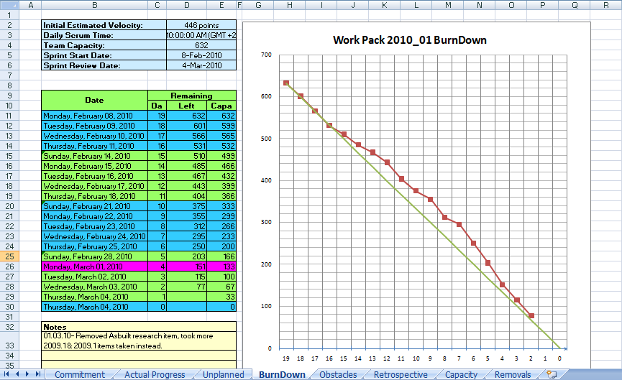
Project Team Sprint Burn-down

Slide 30
Other Thoughts

Slide 31
The Move From Projects to Products

Slide 32
The move toward Funding of long Lived Budgets

Slide 33
Questions?

Slide 34
Change History
2017-03-13: New Version. Revamped to reflect Solution (Vs Software Focus) Focus and reduced to section on Agile MindSet, and Reporting.
2012-05-29: Updated to reflect current Scrum Team training (significant changes). Added DeMarco quote.
2010-11-17: Added “metrics” section based on Scott Downey’s work. Added section on user stories. Updated exercise to be based on real data.
2010-11-05: Added Agile EVM slides as sample. Added discussion about “critical chain.”
2010-11-04: New presentation based on Technip DDMS, “Agile at Scale”, and requirements from project team for estimation.

Slide 35
Support Slides

Slide 36
EVM Approach
Note: Many Organizations Feel they Need This, but then find it creates a bunch of work that is never actually required.

Slide 37
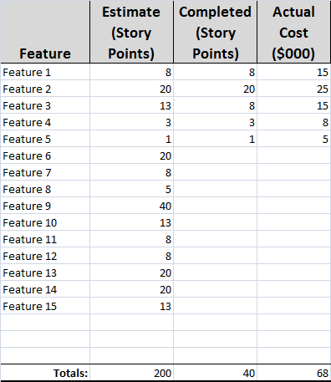
Earned Value Metrics for Agile Projects
Assumptions:
Project budget is $175,000
Status after completing 1 of 4 Sprints
Expected percent complete: 25% (1 of 4)
Planned value
Expected percent complete * Total value
$43,750 = 25% * $175,000
Actual percent complete
Total story points completed / Total story points planned
20% = 40 / 200
Earned value
Actual percent complete * Total budget
$35,000 = 20% * $175,000
Cost performance index (CPI)
Earned value / Actual cost
0.53 = $35,000 / $65,000
Conclusion - Estimate cost at completion
$330,188 = $175,000 / 0.53
We are 47% over budget
And we know this after 1 sprint.
Notes:
Source: Sulaiman, Tamara and Hubert Smits, “Measuring Integrated Progress on Agile Software Development Projects.”

Slide 38
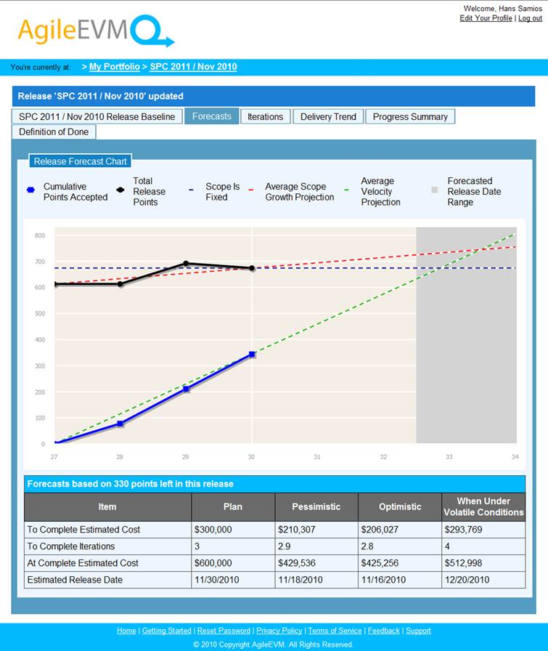
Or Use AgileEVM.com Application

Slide 39
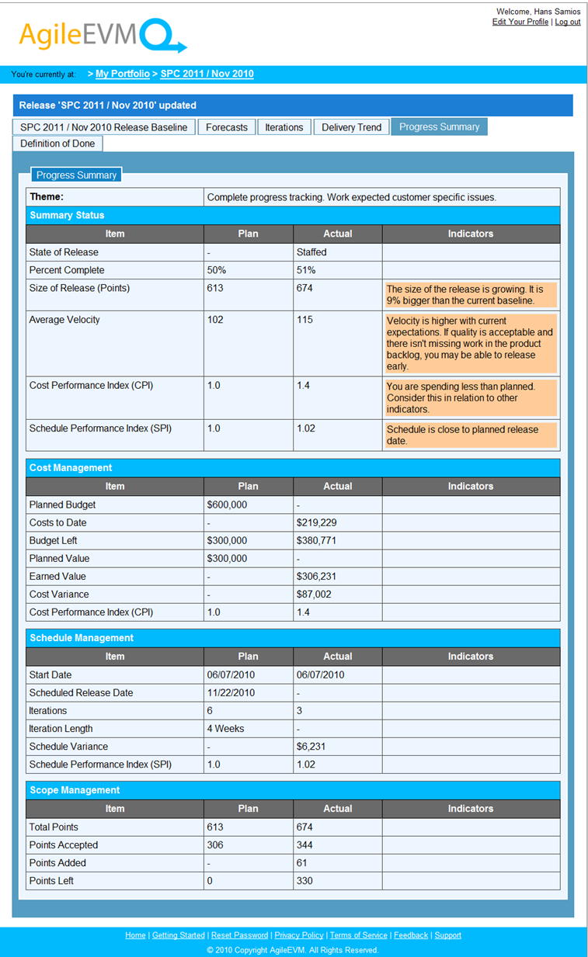
Or Use AgileEVM.com Application

